Slide 1
Data Interaction and Visual Analytics
CS 526
Spring 2022
Covid Interactive Outbreak Tracker
Team members: Jacob Celestine, Nisha Kumari, Sihao Sun
Group number: 10

Slide 2
Project Goals:
Develop graphical representation of Covid 19 Coronavirus Interactive Outbreak Tracker
We will use Plotly to showcase the plots. Through these interactive plots our goal is to expand user capabilities and provide a graphical answer to some of the important questions.
[We decided to use this data and this scheme of plots because somehow or the other we all are a part of some section of data and its very relatable]
Data Set Features
  Size: 1 Gb
  Format : CSV
  Data is at Rest
  Data is Time Variant across days, Months, and Year
  Time an essential component of the required data processing

Slide 3
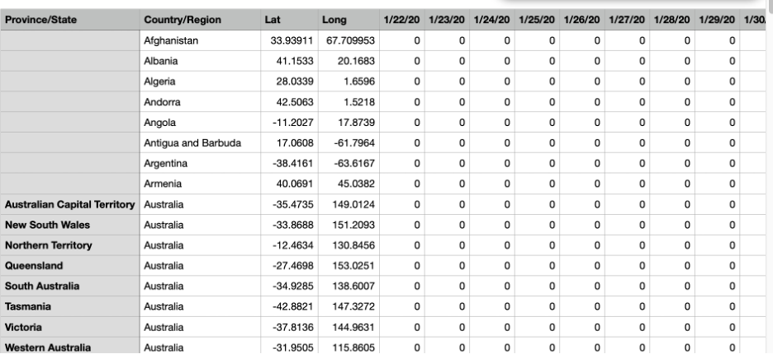
Data Set
Data source provided by John Hopkins University
url_confirmed = https://raw.githubusercontent.com/CSSEGISandData/COVID-19/master/csse_covid_19_data/csse_covid_19_time_series/time_series_covid19_confirmed_global.csv [Volume: 1 mb]
url_deaths = https://raw.githubusercontent.com/CSSEGISandData/COVID-19/master/csse_covid_19_data/csse_covid_19_time_series/time_series_covid19_deaths_global.csv [Volume: 1 mb]
url_recovered = https://raw.githubusercontent.com/CSSEGISandData/COVID-19/master/csse_covid_19_data/csse_covid_19_time_series/time_series_covid19_recovered_global.csv [Volume: 1 mb]
CDC Geographic Data: https://data.cdc.gov/Case-Surveillance/COVID-19-Case-Surveillance-Public-Use-Data-with-Ge/n8mc-b4w4/data [Volume: 1 gb]

Slide 4
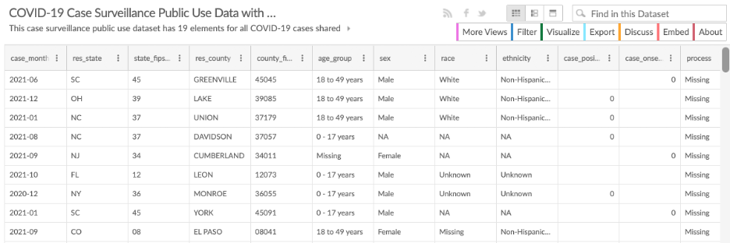
DataSet Sample

Slide 5
Questions
Spread of coronavirus across the world across the days of the year
Recovery rate of Coronavirus across the world across the days of the year
Does adjusting for a country's population size make the data easier to read?
Covid cases by Classifications: [Death, Recovery, Confirmed cases by Date and classified by age, location etc

Slide 6
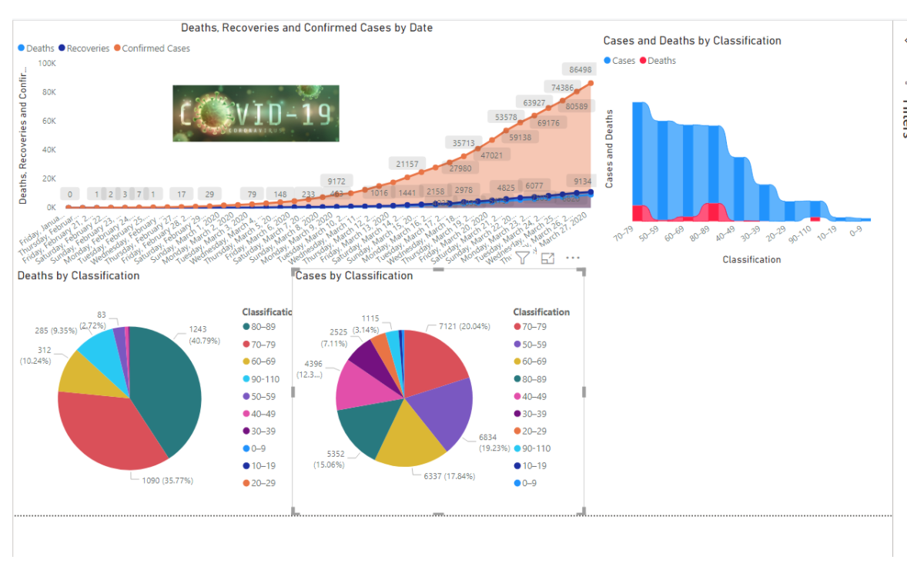
Visual representation Mock-up

Slide 7
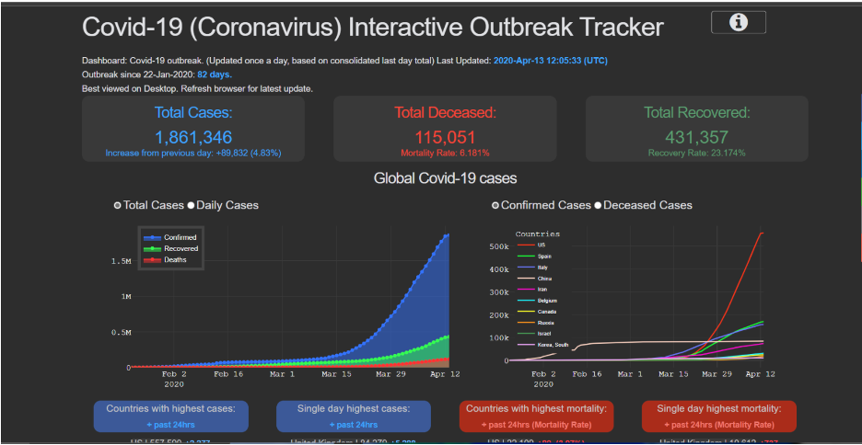

Slide 8
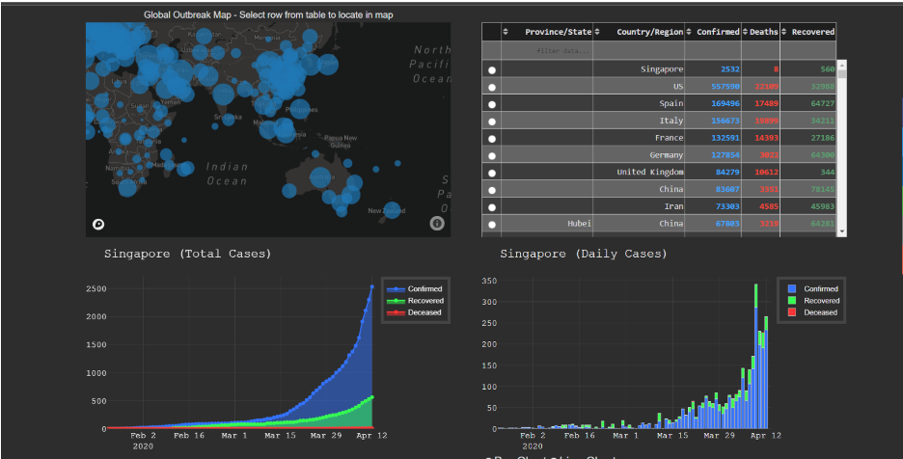

Slide 9
References:
https://moderndata.plotly.com/covid-19-dash-apps/
https://raw.githubusercontent.com/CSSEGISandData/COVID-19/master/csse_covid_19_data/csse_covid_19_time_series/time_series_covid19_confirmed_global.csv
https://raw.githubusercontent.com/CSSEGISandData/COVID-19/master/csse_covid_19_data/csse_covid_19_time_series/time_series_covid19_deaths_global.csv
https://raw.githubusercontent.com/CSSEGISandData/COVID-19/master/csse_covid_19_data/csse_covid_19_time_series/time_series_covid19_recovered_global.csv
https://data.cdc.gov/Case-Surveillance/COVID-19-Case-Surveillance-Public-Use-Data-with-Ge/n8mc-b4w4/data

Slide 10
Thank you

